Slide 1
Banking App
Muhammad Taha | Muhammad Talha | Muhammad Shaheer
Saif Ullah | Jawad Akbar

Slide 2
Outline
Introduction
UML Diagrams
Implementation
Exception Handling
Unit Test
Publishing to GitHub

Slide 3
Introduction
Key Features of the Java Banking Application:
Account creation for users.
Detailed display of all user accounts.
Deposit functionality for adding funds to accounts.
Withdrawal functionality for deducting funds from accounts.
Balance checking for real-time account status.
Exception Handling Mechanisms
Testing Suite

Slide 4
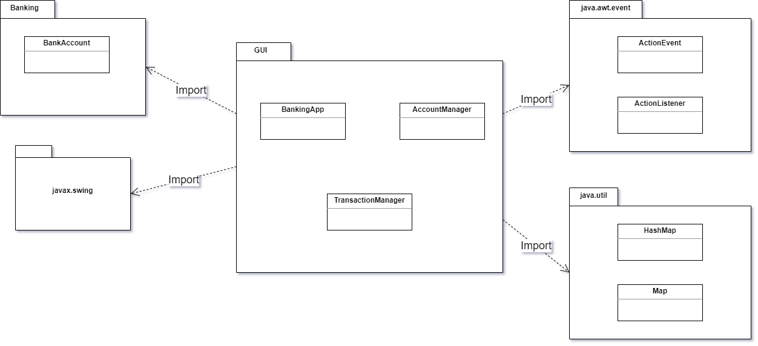
UML Diagrams: Package

Slide 5
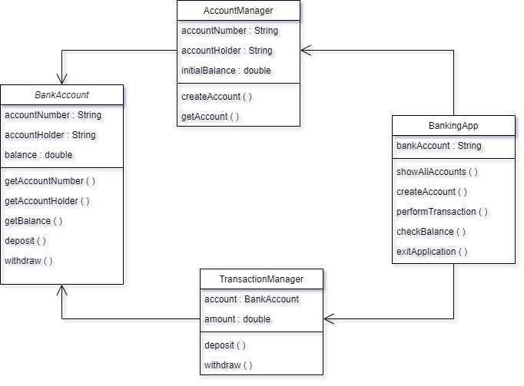
UML Diagrams: Class

Slide 6
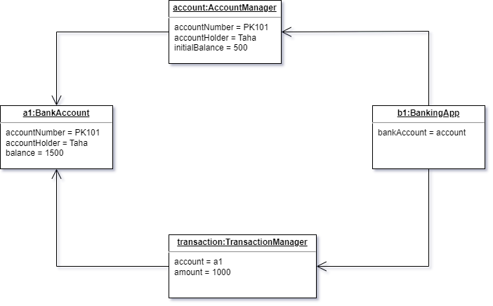
UML Diagrams: Object

Slide 7
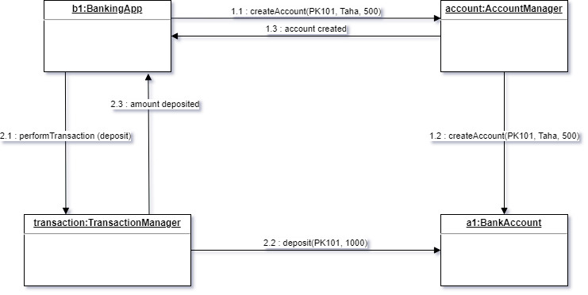
UML Diagrams: Communication

Slide 8
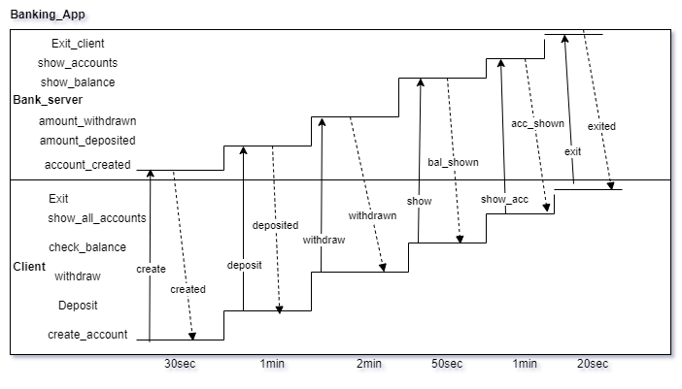
UML Diagrams: Timing

Slide 9
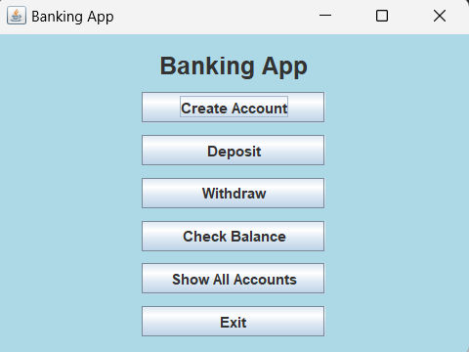
Implementation

Slide 10
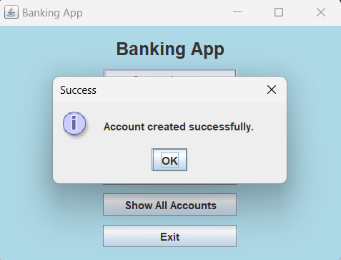
Implementation

Slide 11
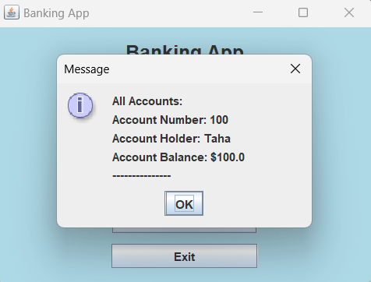
Implementation

Slide 12
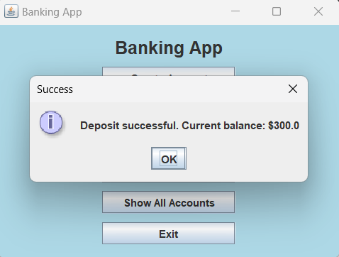
Implementation

Slide 13
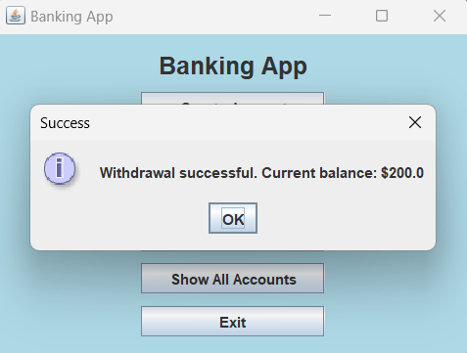
Implementation

Slide 14
Exception Handling
The provided Java banking application demonstrates a thoughtful approach to exception handling, ensuring a robust and user-friendly experience.
Input Validation
NumberFormatException Handling
Transaction Processing

Slide 15
Unit Test 1
Test case 1: Deposit Money (Valid)
Test Case ID | 1
Input | Current Balance: 100 New Deposit: 200
Partition tested | Valid Class
Expected Output | Deposit successful. Current balance: $300.0
Actual Output | Deposit successful. Current balance: $300.0
Pass/Fail | Pass

Slide 16
Unit Test 2
Test case 2: Deposit Money(Invalid)
Test Case ID | 2
Input | Current Balance: 10000 New Deposit: 9999999
Partition tested | Invalid Class
Expected Output | Deposit amount exceeds the maximum limit of $1,000,000. Deposit failed.
Actual Output | Deposit amount exceeds the maximum limit of $1,000,000. Deposit failed.
Pass/Fail | Pass

Slide 17
Unit Test 3
Test case 3: Deposit Money (Invalid)
Test Case ID | 3
Input | Current Balance: 100 New Deposit: -1
Partition tested | Invalid Class
Expected Output | Invalid deposit amount. Please enter a positive value.
Actual Output | Invalid deposit amount. Please enter a positive value.
Pass/Fail | Pass

Slide 18
Unit Test 4
Test case 4: Withdraw Money (Valid)
Test Case ID | 4
Input | Current Balance: 100 Withdraw Amount: 50
Partition tested | Valid Class
Expected Output | Withdrawal successful. Current balance: $50.0"
Actual Output | Withdrawal successful. Current balance: $50.0"
Pass/Fail | Pass

Slide 19
Unit Test 5
Test case 5: Withdraw Money (Invalid)
Test Case ID | 5
Input | Current Balance: 100 Withdraw Amount: 200
Partition tested | Invalid Class
Expected Output | Insufficient funds. Withdrawal failed.
Actual Output | Insufficient funds. Withdrawal failed.
Pass/Fail | Pass

Slide 20
Unit Test 6
Test case 6: Withdraw Money (Invalid)
Test Case ID | 6
Input | Current Balance: 100 Withdraw Amount: -1
Partition tested | Invalid Class
Expected Output | Invalid withdrawal amount. Please enter a positive value.
Actual Output | Invalid withdrawal amount. Please enter a positive value.
Pass/Fail | Pass

Slide 21
Publishing to GitHub
The source code for the Java banking application has been successfully uploaded to GitHub and is now accessible at the following URL: https://github.com/raja-taha/SCD-Final-Project.
This GitHub repository serves as a centralized platform for version control, collaboration, and transparent management of the project's development.

Slide 22
Thankyou

